Slide 1
Fine-Tuning LLM for Medical Diagnosis
Group 3: Yuting Bu, Jing Cao, Shih-Ju Fu
INFO 7374 Spring 2026

Slide 2
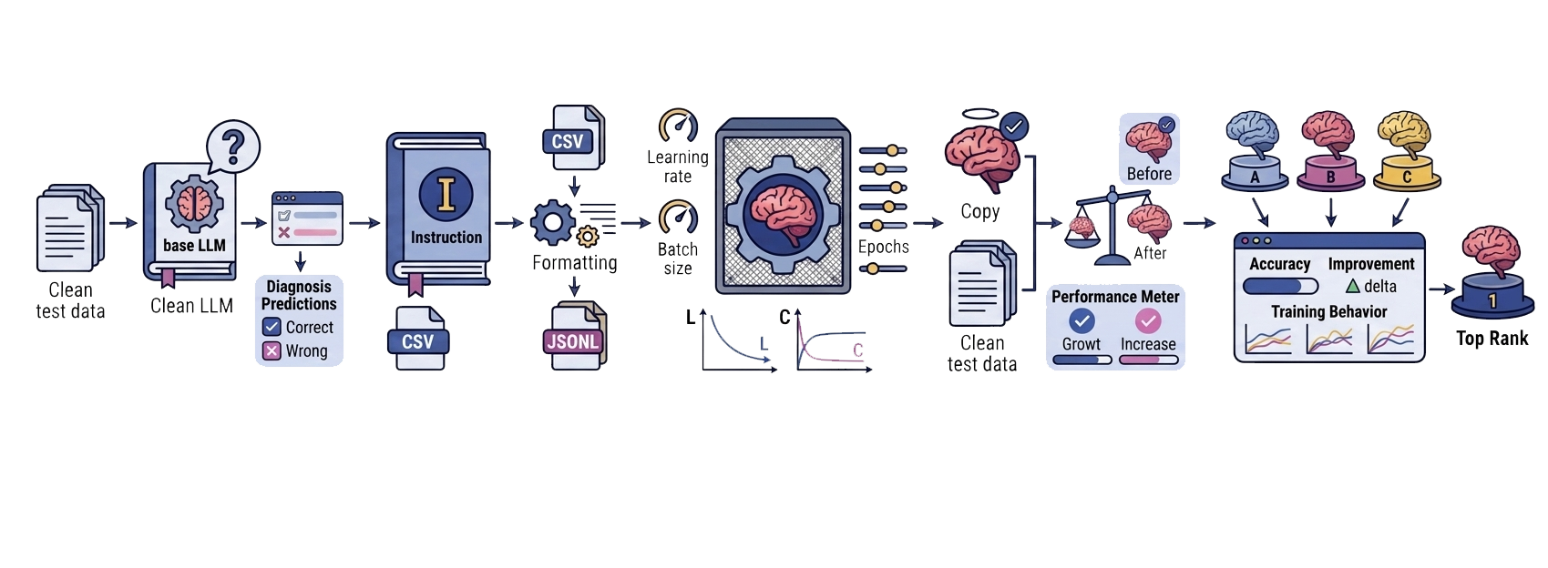
Project Overview
1. Baseline Evaluation
2. Data Preparation
3. Model Fine-Tuning
4. Post Fine-Tuning Evaluation
5. Group Comparison
Notes:
Here's our pipeline. There are Five stages. First we took the base model and ran it on our test cases to see how it does out of the box, that's our baseline. Then we prepped the data, added instructions to every query, formatted everything into CSV, and converted it to JSONL for OpenAI's API. Third, each of us fine-tuned the model with a different set of hyperparameters. After that we ran the same test cases again on our fine-tuned models and compared before and after. And then finally we put all three of our results together and figured out which setting actually worked best.

Slide 3
Datasets
1. Fine-Tuning Dataset
2. Validation Dataset
3. Test Dataset
Used to train the model
Contains labeled diagnostic data
Used during training
Monitors model performance and loss
Used for final evaluation
Contains
New Samples
Fine-tuned Samples
Correct diagnosis labels
Notes:
We used Three datasets. The fine-tuning dataset is what we used to actually train the model. It's got labeled medical cases with patient conditions and correct diagnoses. The validation dataset is a separate set we used during training to monitor the loss and make sure the model isn't just memorizing the training data. And then the test dataset is what we evaluated on. It has two sheets. New Samples are 20 cases the model has never seen before, completely outside the training distribution. And Fine-Tuned Samples are 20 cases that come from the same kind of data the model was trained on. Each one has a correct diagnosis label that we compare the model's first diagnosis against.

Slide 4
Baseline Evaluation
gpt-4o-mini-2024-07-18
Samples | Accuracy | Correct/Total
New | 25% | 5/20
Fine-Tuned | 58% | 12/20
Overall | 43% | 17/40
Prompt: “Suppose that you are a medical diagnosis assistant, skilled in recognizing diseases and prescribing treatments. If a patient has the following condition, give me the most probable diagnosis and the related probability and urgency and rationale for the diagnosis besides suitable treatments. Start your response with Diagnosis: "
Notes:
So before we did any fine-tuning, we tested the base GPT-4o-mini on all 40 test cases. You can see the prompt we used at the bottom. We told the model to act as a medical diagnosis assistant and to start its response with a diagnosis, followed by probability, urgency, rationale, and treatment. We used this exact same prompt for every single evaluation, before and after fine-tuning, so the comparison is fair.
The results were not great. 25% on New Samples, so only 5 out of 20 correct. 58% on Fine-Tuned Samples, 12 out of 20. Overall 43%, which is 17 out of 40. The model really struggled with the more complex and rare conditions. Things like Cerebral Malaria, it kept saying Neurocysticercosis. Necrotizing Fasciitis with sepsis, it couldn't get that either. And multi-part diagnoses like septic arthritis with brucella infection, it would get part of it but miss the full picture. So there was definitely room to improve

Slide 5
Hyperparameters
Model | Learning Rate | Epochs | Batch
A (Jing) | 0.4 | 5 | 8
B (ShihJu) | 1 | 5 | 4
C (Yuting) | 0.4 | 7 | 4
Notes:
To try to improve that, each of us fine-tuned the model with a different configuration. Model A has a learning rate of 0.4 with a batch size of 8 and 5 epochs. Model B has a much higher learning rate at 1.0, batch size of 4, same 5 epochs. And Model C has the same learning rate as A at 0.4, but a smaller batch size of 4 and runs longer at 7 epochs. So we can compare what happens when you crank up the learning rate, what happens when you add more epochs, and what effect batch size has.

Slide 6
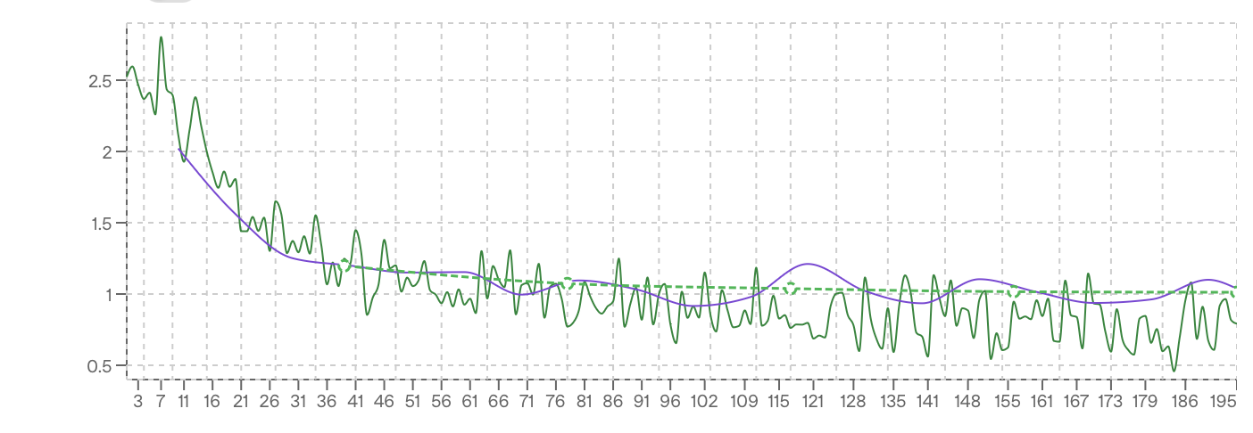
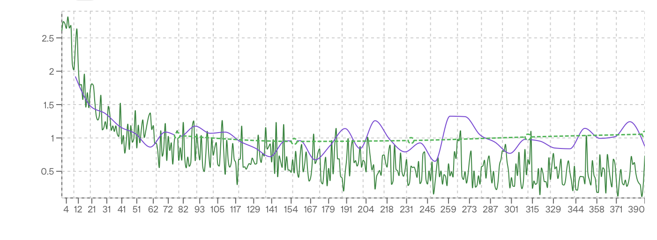
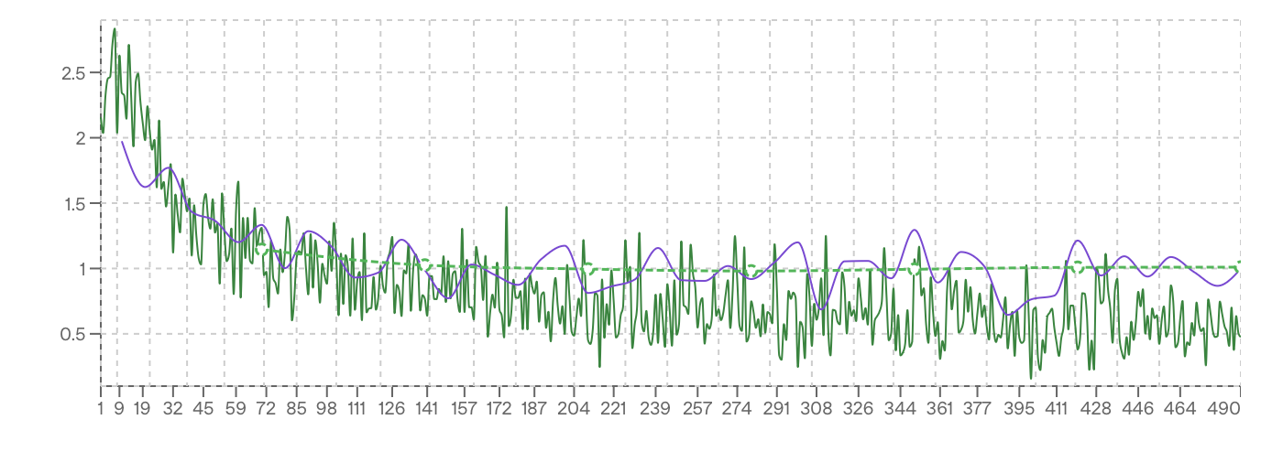
Training Loss
Model A
Learning Rate: 0.4
Epochs: 5 Batch Size: 8
195 Steps
Key observations:
All three: ~2.5 → ~1.0
Model A (LR=0.4, BT=8): Smoothest convergence
Model B (LR=1.0): Fastest drop, most erratic
Model C (LR=0.4, EP=7): Longest run, training loss drifts below validation loss
Model B
Learning Rate: 1
Epochs: 5 Batch Size: 4
390 Steps
Model C
Learning Rate: 0.4
Epochs: 7 Batch Size: 4
490 Steps
Notes:
These are the training loss charts from the OpenAI dashboard. The green jagged line is the raw training loss, the purple smooth line is a smoothed version, and the green dashed line is validation loss.
All three started around 2.5 and came down to roughly 1.0, so they all learned something. But the behavior is really different. Model A on top is the cleanest. The batch size of 8 means each gradient update is averaging over more examples, so there's less noise. And if you look at the training and validation lines, they stay pretty close together the whole time. That's good, it means it's not overfitting.
Model B in the middle dropped the fastest in the beginning because of that high learning rate. But look at how noisy it is, especially in the second half. The loss is bouncing around between like 0.3 and 1.3 even toward the end. It never really settled down.
Model C at the bottom ran the longest, 490 steps because of the 7 epochs. And if you look at the tail end, the training loss starts dipping below the validation loss. That gap between them is a textbook sign of overfitting. The model is fitting the training data too closely and it's starting to lose some of its general ability

Slide 7
Results - Model A
Learning Rate = 0.4 Epochs = 5 Batch Size = 8
Samples | Before | After | Net
New | 5/20 (25%) | 6/20 (30%) | +1
Fine-Tuned | 11/20 (55%) | 14/20 (70%) | +3
Overall | 16/40 (40%) | 20/40 (50%) | +10%
Wrong → Correct: 4 Correct → Wrong: 0
Notes:
here's what Model A actually produced. New Samples went from 5 out of 20 to 6 out of 20, so plus one there. Fine-Tuned Samples went from 11 out of 20 to 14 out of 20, that's a big jump, 55% to 70%. Overall, 40% to 50%, a 10 percentage point improvement.
And the really important number is at the bottom. 4 cases flipped from wrong to correct, and zero went the other way. Nothing that was correct before got broken by fine-tuning.

Slide 8
Results - Model B
Learning Rate = 1 Epochs = 5 Batch Size = 4
Samples | Before | After | Net
New | 6/20 (30%) | 6/20 (30%) | 0
Fine-Tuned | 12/20 (60%) | 12/20 (60%) | 0
Overall | 18/40 (45%) | 18/40 (45%) | 0%
Wrong → Correct: 1 Correct → Wrong: 1
Notes:
Model B, the high learning rate one. Nothing happened. 45% before, 45% after. In New Samples there was one case that got fixed, case 18, but case 16 which was correct before became wrong after, so they canceled out. And in Fine-Tuned Samples, literally every single case stayed exactly the same. Not one change. The fine-tuned model was basically behaving the same as the base model. All that training and it didn't learn anything useful.

Slide 9
Results - Model C
Learning Rate = 0.4 Epochs = 7 Batch Size = 4
Samples | Before | After | Net
New | 4/20 (20%) | 5/20 (25%) | +1
Fine-Tuned | 12/20 (60%) | 14/20 (70%) | +2
Overall | 16/40 (40%) | 19/40 (48%) | +8%
Wrong → Correct: 6 Correct → Wrong: 3
Notes:
Model C went from 40% to 48%, so an 8 point improvement. New Samples went from 4 to 5, Fine-Tuned went from 12 to 14. But look at the bottom. 6 cases went from wrong to correct, which is actually the most of any model. But 3 cases went from correct to wrong. So the model learned new things but it also forgot things it already knew. In New Samples alone, 3 got fixed but 2 broke. That instability is consistent with what we saw in the loss chart, where training loss was drifting below validation loss.

Slide 10
Group Comparison
Model | Before | After | Change | Correct→ Wrong
A | 40% | 50% | +10% | 0
B | 45% | 45% | +0% | 1
C | 40% | 48% | 8% | 3
Notes:
Here's all three side by side. Model A, plus 10%, zero correct to wrong. Model C, plus 8%, but 3 correct to wrong. Model B, zero change, and it still managed to break one case. Model A is the clear winner, both in how much it improved and in how cleanly it did it.

Slide 11
Breakdown by Sample Type
Model | New Before | New After | FT Before | FT After
A | 25% | 30% | 55% | 70%
B | 30% | 30% | 60% | 60%
C | 20% | 25% | 60% | 70%
Notes:
Now if we break it down by sample type, there's a really clear pattern. Fine-Tuned Samples improved a lot for Models A and C, both hitting 70%. But New Samples barely moved for anyone. Model A went from 25 to 30, Model C from 20 to 25, Model B didn't move at all. The model gets better at stuff that looks like what it trained on, but it doesn't really help with cases it's never seen. That makes sense because fine-tuning is essentially teaching the model patterns from the training data, not teaching it medicine in general.

Slide 12
Stability Analysis
Model | Wrong → Correct | Correct → Wrong | Net Gain
A | 4 | 0 | 4
B | 1 | 1 | 0
C | 6 | 3 | 3
Notes:
This is the stability breakdown. Model A fixed 4 and broke zero, net gain of 4. That's the cleanest result. Model C actually fixed the most at 6, more than A, but it also broke 3, so net gain is only 3. And Model B had one fix and one break, netting zero. So if you're thinking about which model you'd actually trust, it's not just about how many it got right. It's about whether fine-tuning made it worse on anything. Model A is the only one where the answer to that is no

Slide 13
Key Findings
01
02
03
Hyperparameters
Model Behavior
Model A
Moderate LR (0.4) + larger batch size (8) = best accuracy and stability
High LR (1.0) = no improvement, too aggressive for this task
More epochs (7) = more learning but also more forgetting
Fine-tuned samples improved significantly, new samples barely moved
Fine-tuning specializes the model on its training distribution, it doesn't generalize
Highest accuracy (50%), largest gain (+10%), zero correct → wrong
Notes:
The key findings through our project is, first on the hyperparameter side, moderate learning rate with a bigger batch size was the sweet spot. High learning rate at 1.0 just didn't work for this task, it was too aggressive. And more epochs at 7 did help the model learn more, but it came with a cost, it started forgetting things.
On model behavior, the improvement was almost entirely in fine-tuned samples. New samples, the ones the model hadn't been trained on, barely moved across all three configs. So fine-tuning makes the model better at its own training distribution, but it doesn't generalize.
And the bottom line, Model A won on every metric. Highest accuracy, biggest gain, zero regressions.

Slide 14
Why Model A Performed Best?
01
02
03
Results
LR = 0.4
Batch Size = 8
Epochs = 5
Moderate learning rate avoids overshooting optimal weights, unlike LR=1.0 which caused instability
Largest batch of the three, averages more examples per update, producing smoother gradient estimates and a cleaner loss curve
Enough passes to converge without the drift seen in 7 epochs, where the model started forgetting previously correct cases
Best trade-off between adaptation and generalization, the model learned without breaking anything
Notes:
why did Model A actually win? Three things working together.
The learning rate of 0.4 is aggressive enough to learn but it doesn't overshoot. We saw what 1.0 did with Model B. The updates were too big, the model couldn't settle into better weights, and it ended up basically the same as before.
Batch size of 8 is double what B and C used. That means every gradient update is computed over more examples, which smooths out the noise. You could literally see it in the loss curve, A's was way cleaner than the other two.
And 5 epochs was just the right amount of training. Model C went for 7, and that's where it started drifting. The training loss dropped below validation loss, and the model began forgetting cases it already got right. A stopped at the right time.
Put it all together and you get the best trade-off. The model adapted to the training data without overfitting or breaking anything.

Slide 15
Conclusion
01
02
03
What Worked?
What Didn’t
Limitations
Fine-tuning improved diagnosis accuracy by up to +10%
Moderate LR (0.4) + larger batch size (8) + 5 epochs = best results with zero regressions
High learning rate (1.0) produced no improvement
More epochs (7) improved accuracy but caused the model to forget previously correct cases
Fine-tuning helps with cases similar to training data, but doesn't generalize to unseen conditions
Notes:
So to wrap up. What worked: fine-tuning did improve diagnosis accuracy, up to 10 points with the right settings. Moderate learning rate, bigger batch size, and 5 epochs gave us the best results with zero regressions.
What didn't: the high learning rate of 1.0 was a dead end. And 7 epochs improved accuracy but the model started forgetting previously correct answers.
And the bigger limitation here is that fine-tuning helps with cases that look like the training data, but it doesn't make the model better at diagnosing things it's never seen. For that you'd probably need a lot more training data, or something like retrieval-augmented generation where the model can pull in reference material at inference time.

Slide 16
Thanks!
Do you have any questions?

